Slide 1


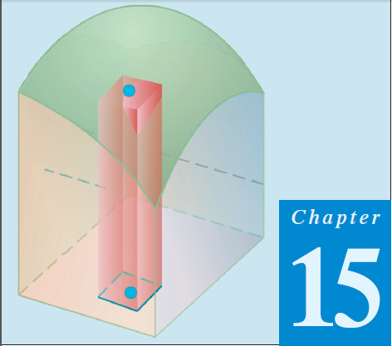
Thomas Calculus 11th
11
Triple Integral in Cartesian Regions
Samuel Lukas

Slide 2

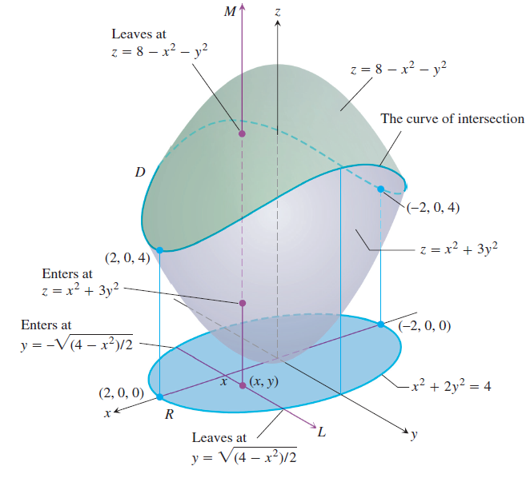




Rectangular Coordinate

Slide 3
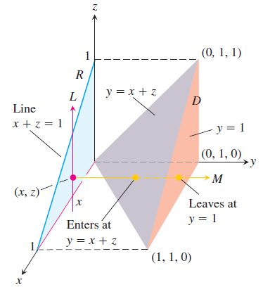


Set up the limits of integration for evaluating the triple integral of a function F(x, y, z) over the tetrahedron D with vertices (0, 0, 0), (1, 1, 0), (0, 1, 0), and (0, 1, 1).

Slide 4
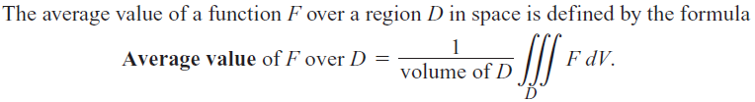
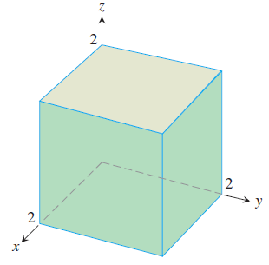




Average Value of a Function in Space

Slide 5

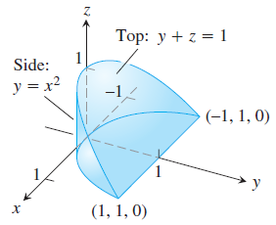
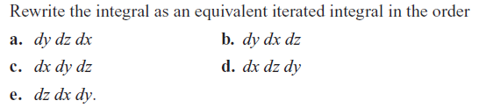

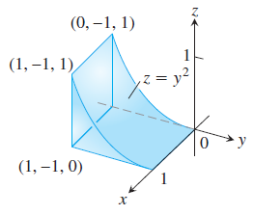
Exercises 1
1.
2.

Slide 6

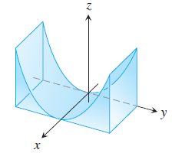
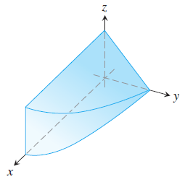
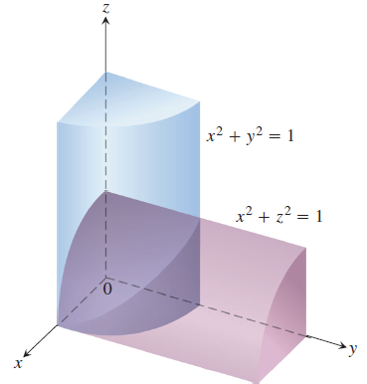
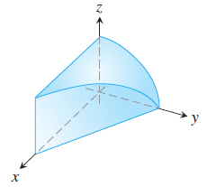
In Exercises 3 – 6, evaluate the volumes of the regions .
3.
4.
5.
6.

Slide 7





In Exercises 7 – 10, changing the order of integration.
07.
08.
09.
10.
In Exercises 11 – 40, find the average value of F(x, y, z) over the given region.
11.
12.

Slide 8

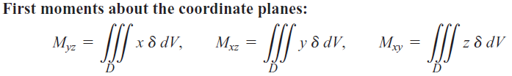



Masses and Moments in 3D

Slide 9
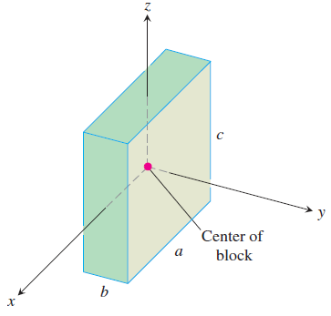






Examples 1

Slide 10

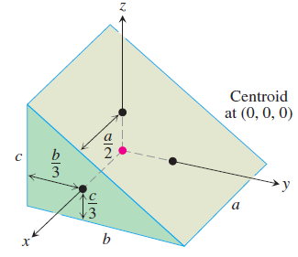
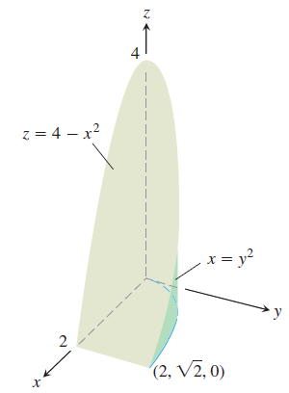

Exercises 2
13
14.
Find the mass of the given solid and the center of mass figure (2) if

